Slide 1
Security Tools for Information Security
ENPM685

Slide 2

Network Analysis Tools

Slide 3
The Internet is a Series of Tubes
The content of the Internet is packets of data
Most of it is TCP, then UDP, and finally some ICMP
These are all encapsulated in IP
If you haven’t had a lot of exposure to the core of TCP/IP and network PLEASE read the Networking Primer to build that knowledge
This is the #1 skill I see lacking in students and job applicants

Slide 4
Ports
1 - 65535
Way to hold conversations across different hosts/networks/etc
IANA assigns most ports, but also “defacto”
21, 22, 25, 53, 80, 135, 443, 1433, 3306, 3389
What’s port 80?
What’s port 3389?
What’s port 3306?
What’s port 9200?

Slide 5
Defensive security requires visibility
You can’t stop Bad ThingsTM if you can’t see them
This means you need visibility on the network and on the host to Do It RightTM

Slide 6
Packet Analyzers (Sniffers)
tcpdump
wireshark
ngrep
tshark
ettercap
SolarWinds
Cain and Abel
MS Network Monitor

Slide 7
Misc. Network Tools
ntop
squil
Sysinternals tools (Process Explorer, TCPView)
pcapcat
tcpxtract

Slide 8
We’ll be focusing on
tcpdump
Wireshark

Slide 9
pcap (Packet Capture)
Packet capture interface
libraries (libpcap and winpcap) to facilitate capture and capture file reading/writing
Wrapper libraries in many languages
Also what we call the resulting file

Slide 10
Tapping and Promiscuity
Promiscuous mode: NIC sends all packets (not just those intended for this host) to CPU for processing (often restricted to root users)
Tapping: creating 2 flows of data that are identical from a single flow.
Span port: a router-based tap

Slide 11
Hubs and bridges provide easy sniffing opportunities
Switches require Span Ports
Unless you want to get into
ARP Spoofing/Cache Poisoning
MAC flooding
MAC duplicating

Slide 12
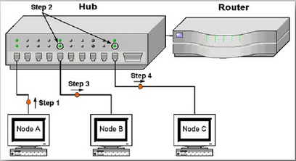
Hub Sniffing

Slide 13
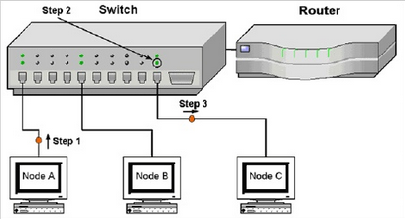
Switch Sniffing

Slide 14
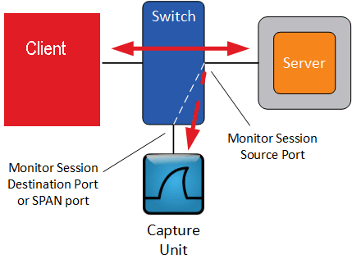
Span Ports

Slide 15
Where to monitor from?
Typically done at the border (looking for bad coming in/out)
This misses that East-West traffic
(stuff that stays internal to your network)
More visibility the further you push monitoring down but costs go WAY up
Can also move monitoring gear as needed

Slide 16
Where to monitor a VM from?
Can do it inside the VM or on your host system
If using the host system I would use filters (”host vm.ip”) so you’re only recording traffic to/from that VM and not other VMs or your host

Slide 17
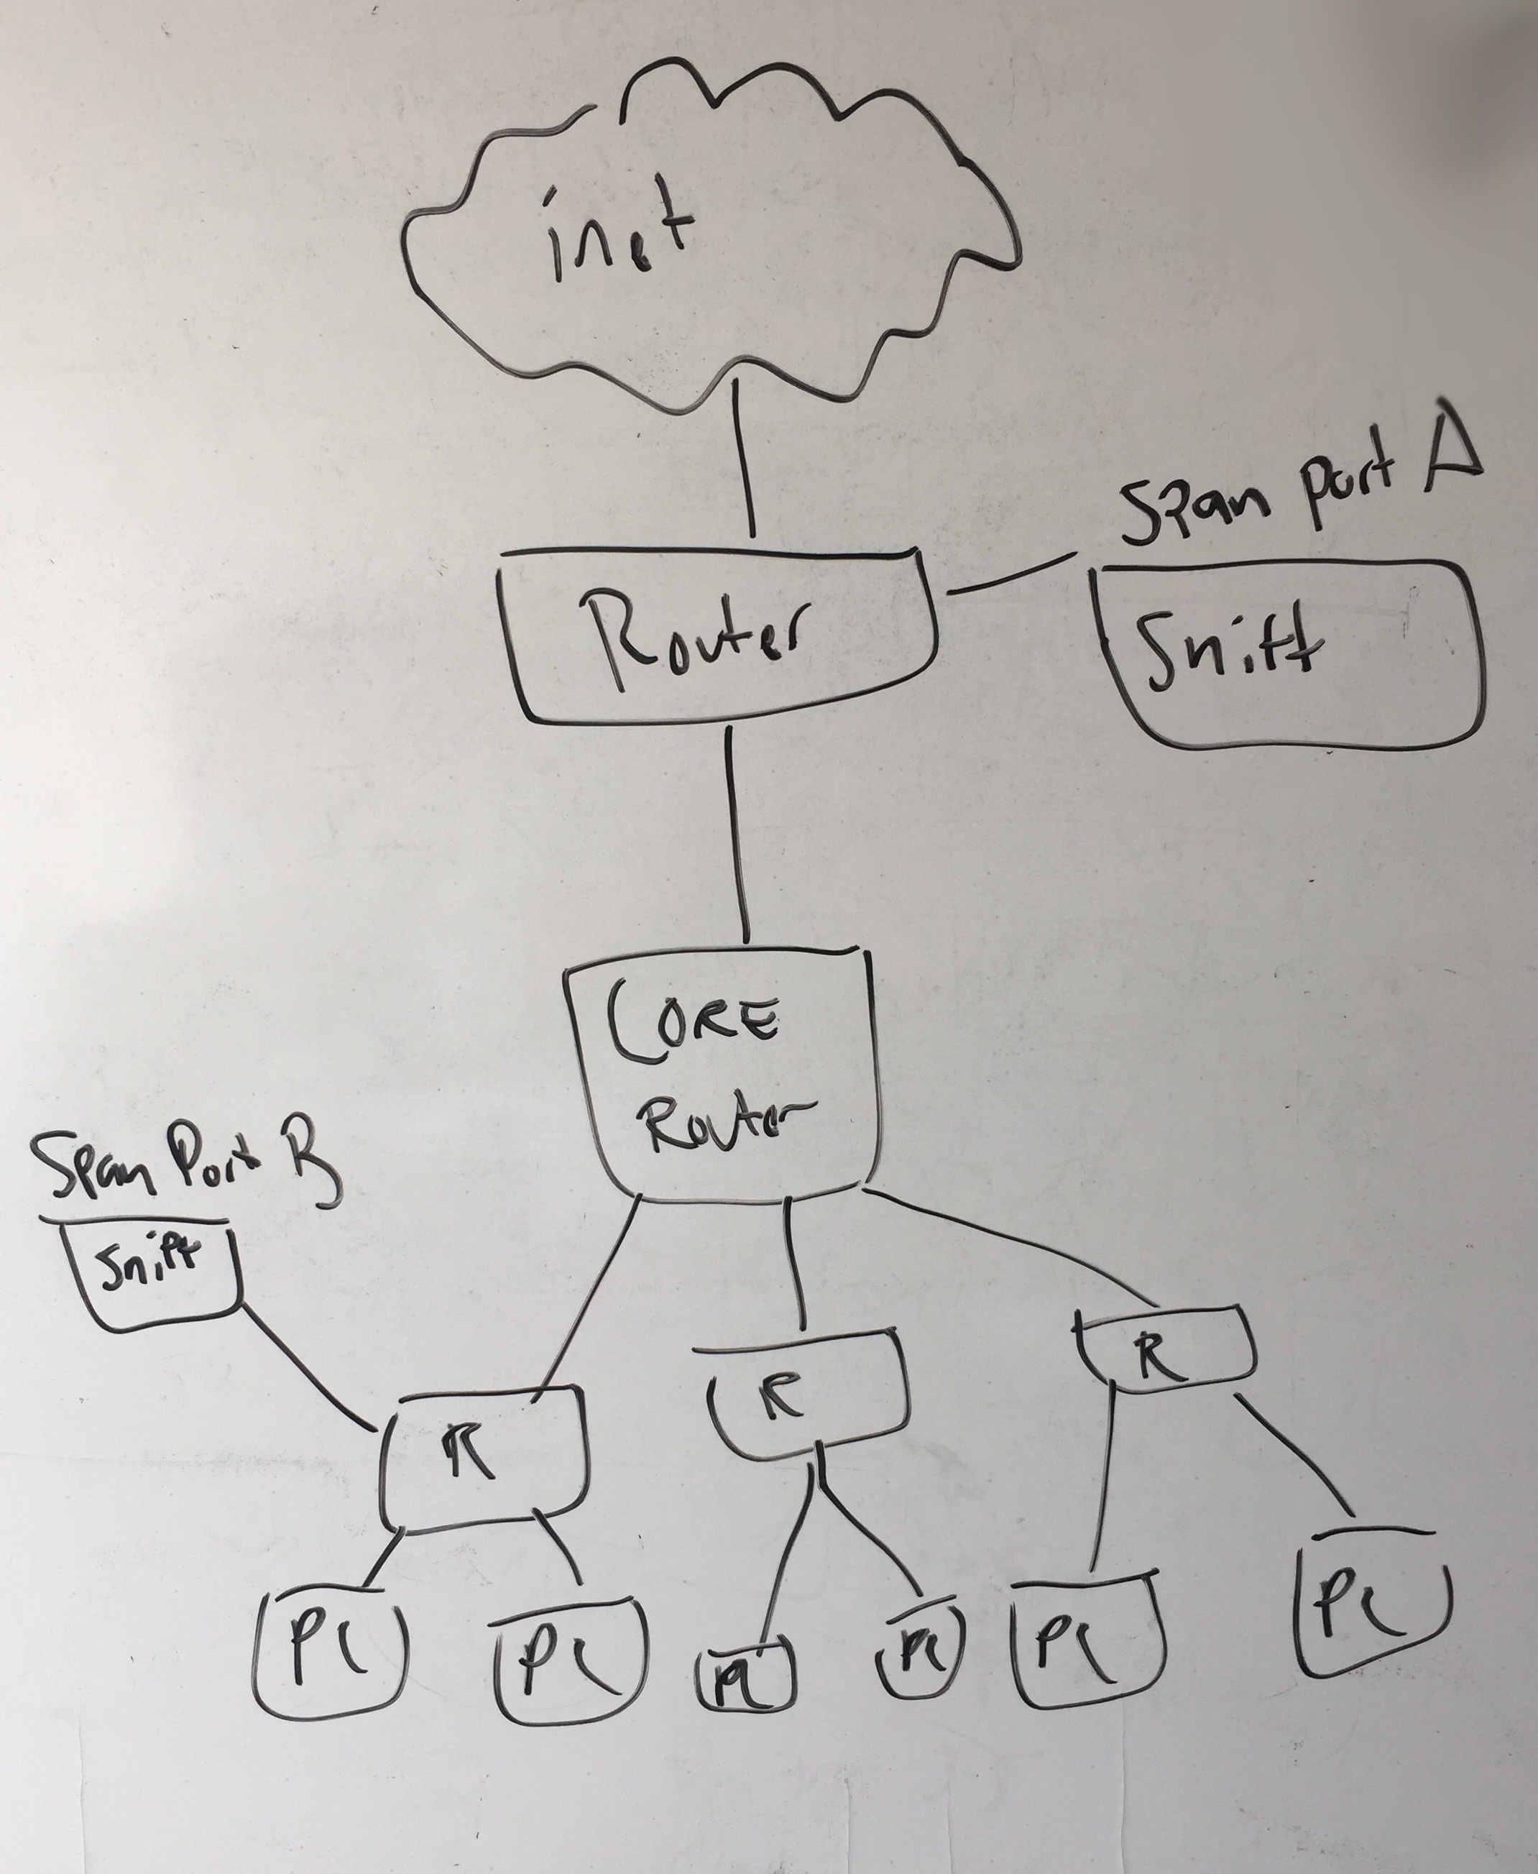

Slide 18
ARP – Address Resolution Protocol
Networking protocol for determining network host’s hardware address (Link Layer) when only it’s IP address (Network Layer) is known.
Request (who has) specifies the IP of a host who’s MAC addr we want
Reply (is at) is the answer a host should send specifying the MAC address associated to that IP addr

Slide 19
ARP Spoofing
A man in the middle (MITM) attack
ARP Cache Poisoning
Send a forged gratuitous ARP reply
Cache is stateless so forged ARP reply is used
Attacker receives traffic
Keeps a copy and forwards on to the actual host

Slide 20
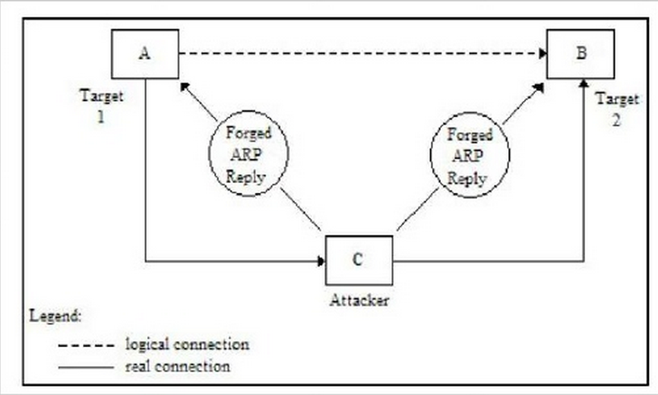
ARP Spoofing

Slide 21
MAC Flooding
MAC table is a fixed size
Attacker floods network/switch with forged MAC address requests
Switch enters a Hub-like mode
Traffic now forwarded to all ports
Boom - Sniff the traffic

Slide 22
MAC Cloning
Attacker changes their MAC address to be the same as the victim’s
Unix:
ifconfig eth0 down
ifconfig eth0 hw ether xx:xx:xx:xx:xx:xx
ifconfig eth0 up
Windows: Via Device Manger
Traffic sent to both hosts

Slide 23
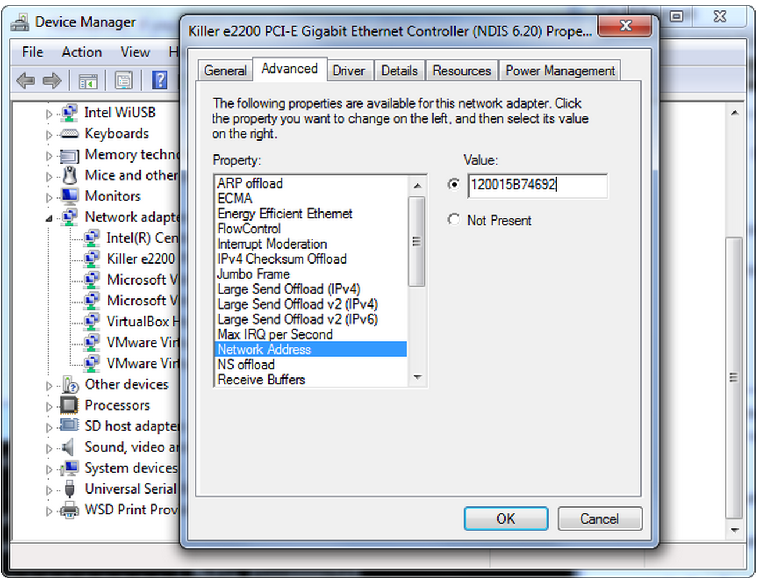
00DEADBEEF00 Anyone?

Slide 24
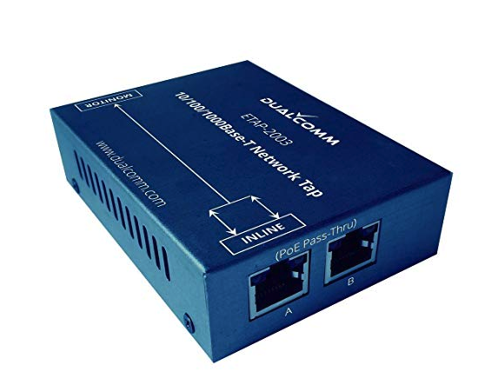
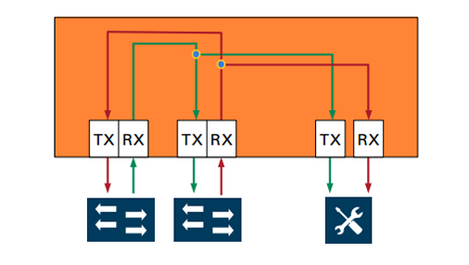
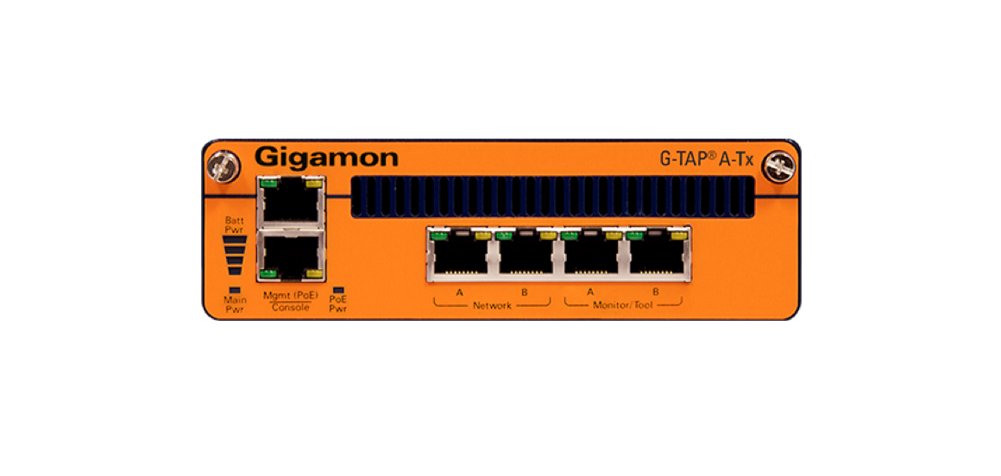
Tap options
Many commercial products
Gigamon ($$$$$)
Net-Optics ($$$)
Throwing Star tap (http://greatscottgadgets.com/throwingstar/)
http://www.instructables.com/id/Make-a-Passive-Network-Tap/

Slide 25
Proper Roles
tcpdump is for traffic capture
ngrep and snort are for searching
Wireshark will do both (with some caveats)

Slide 26
ngrep
grep connected to pcap
allows grep-ing of network traffic visible through pcap

Slide 27
ettercap
Suite of tools for MITM attacks
Allows ARPspoofing and poisoning
Supports some data capture/modification in flight
Ability to add filters and plugins

Slide 28
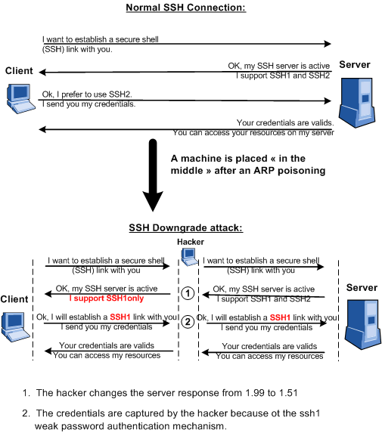

Slide 29
tcpdump Options
-i <interface> (Listen on ”interface”)
interface = network card
-i eth0 (Listen on eth0 inferface)
this is pretty typical for Linux
-i any (Listen on all interfaces)
-D (Show all available interfaces)

Slide 30
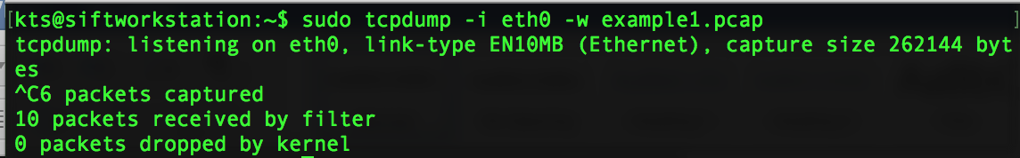
Run tcpdump via sudo/as root
☹
☺

Slide 31
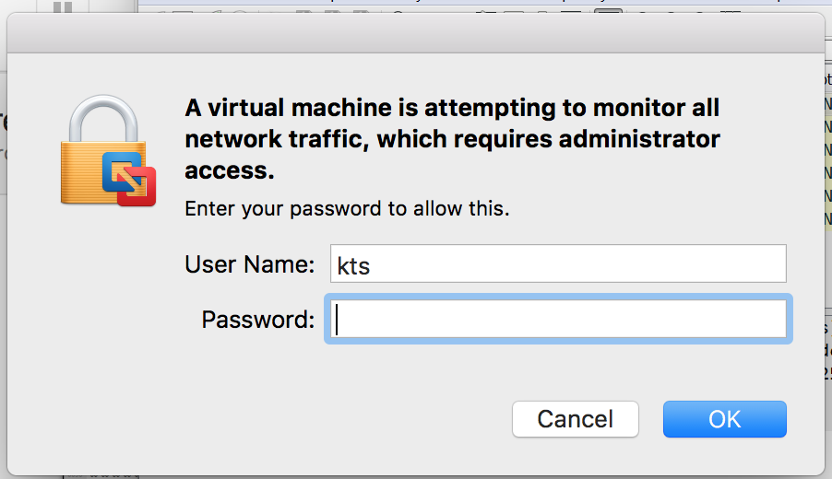
If you’re using VMWware…
VMWare will ask you to authentication when your VM attempts to put its network adapter into promiscuous mode (tcpdump, Wireshark, etc)

Slide 32
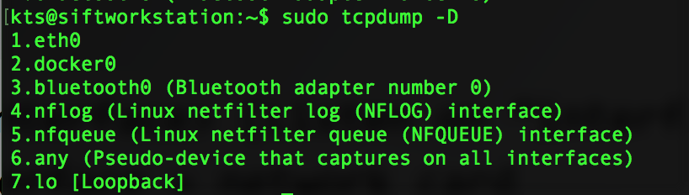
tcpdump -D

Slide 33
tcpdump Options
-n (Don’t resolve hostnames)
-nn (Don’t resolve host or port names)
Can make reading packets easier
-X (Show packet in hex and ASCII)
-XX (same as above + ethernet header)
-t (Give human-readable timestamps)
-v, -vv, -vvv (Verbosity levels)

Slide 34
tcpdump Options
-s X (only get X number of bytes of the packet.)
Use –s 0 to get the whole packet
-c X (only get X number of packets)

Slide 35
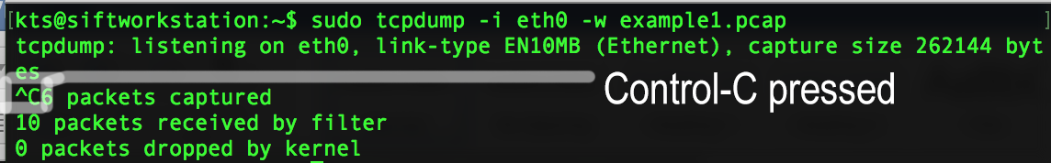
tcpdump Write (record packet capture)
-w <filename> (to save packet capture to disk)
Control-C when you want to stop capture

Slide 36
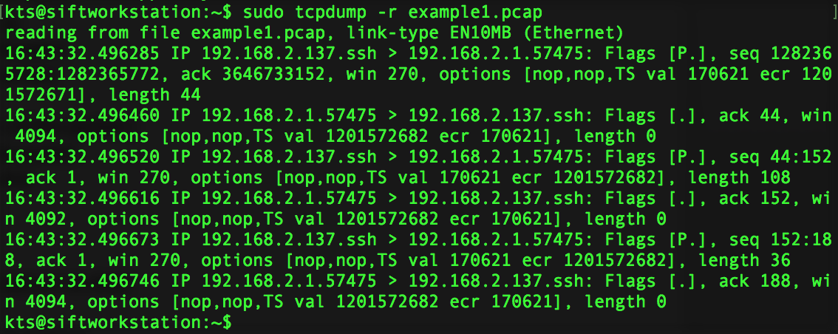
tcpdump Read (review packet capture)
-r <filename> (to read packet capture and process with tcpdump)

Slide 37
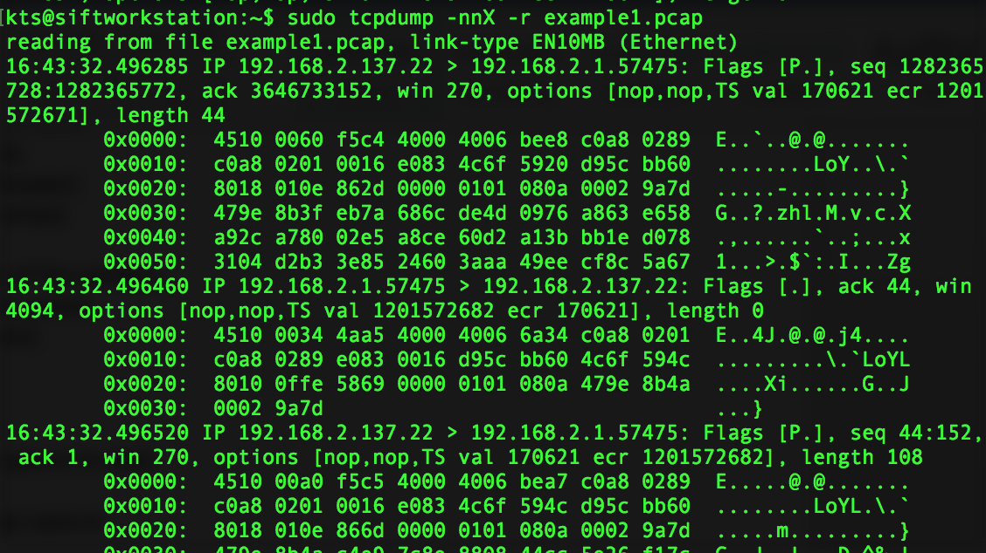
tcpdump –nnX –r <filename>

Slide 38
tcpdump Expressions
Protocol
ether, ip ip6, tcp, udp, arp, rarp
Type
host <host>
net <network>
port <portnumber>
portrange <start-end>

Slide 39
tcpdump Expressions
Direction
src (source IP/port)
src 192.168.2.137
src port 22
dst (destination IP/port)
dst 8.8.8.8
dst port 443

Slide 40
tcpdump Expressions
host 192.168.2.137
net 192.168.2.0/24
port 22
src port 22

Slide 41
tcpdump Expressions
Combine all these with and, or, not
You can use brackets () for complex queries and single quotes ‘
Examples:
tcpdump –nnX tcp and dest 192.168.2.137
tcpdump –nn udp and port 53
tcpdump –nnX 192.168.2.137 and not port 22

Slide 42
tcpdump Expressions
Complex query:
tcpdump –nnX 'src 192.168.2.137 and (dst port 22 or 443)'

Slide 43
tcpdump host host.ip
Show all traffic to/from that host
tcpdump host 192.168.2.137

Slide 44
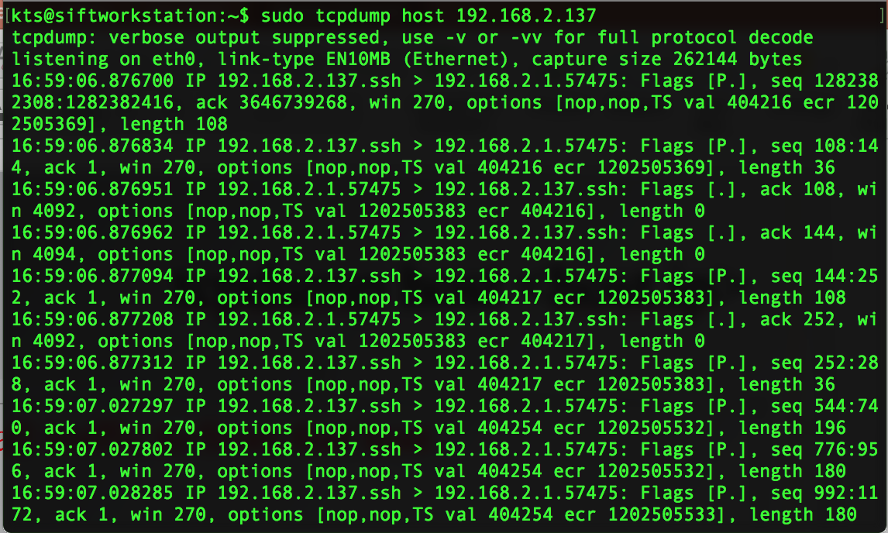
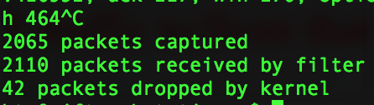
Why so much traffic?

Slide 45
Let’s limit that a bit
tcpdump host 192.168.2.137 and not port 22
Nothing happening, now try opening Firefox and viewing a webpage or try to ping a system from your Kali VM

Slide 46
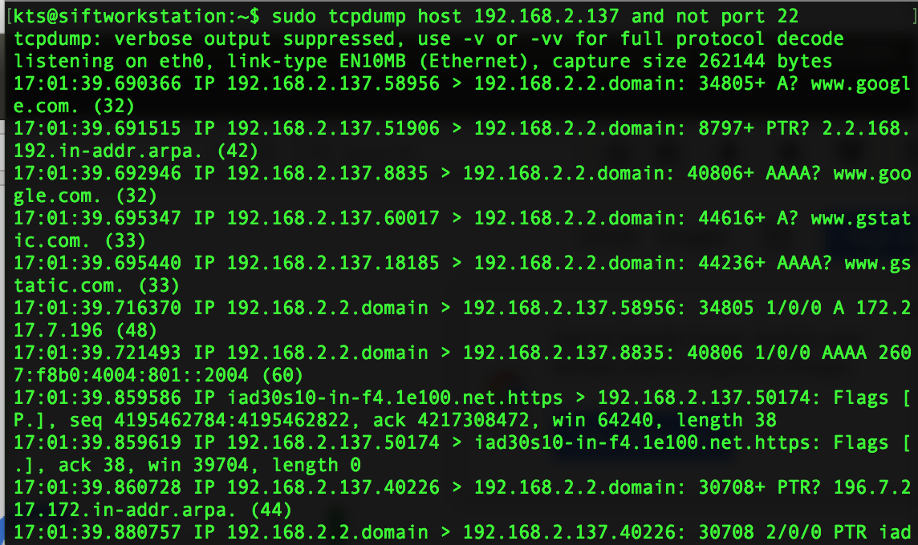

Slide 47
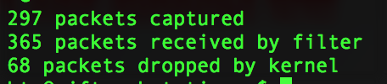
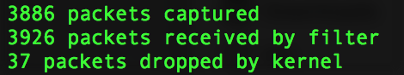
Packet Loss

Slide 48
Packet Loss
With fast network connections comes the need for fast network cards and disks to keep up
Using a VM for packet capture is less than optimal.

Slide 49
tcpdump Exercise #1
tcpdump –nnX –c 1 icmp
What does this do?

Slide 50
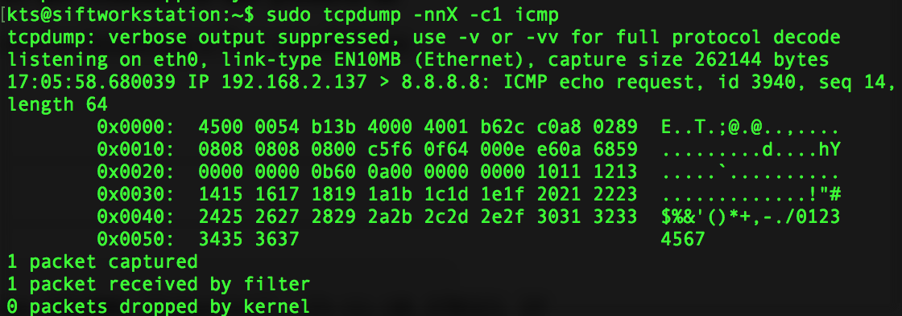
Studying ICMP Traffic

Slide 51
tcpdump Exercise #2
sudo tcpdump -i eth0 -nnX -s 0 -w goterps.pcap host kali.ip and port 443
Open a link like https://www.umd.edu/contact-us
Control-C to stop capture
(also on the class VM as “goterps.pcap”)

Slide 52
tcpdump Exercise #2
Using sudo tcpdump -nnX -s 0 -r goterps.pcap | less
What do you see?
Can you see what URL was accessed?
Where is www.umd.edu hosted?
Can you see who the SSL Certificate Authority is?

Slide 53
tcpdump Exercise #2
What do you see?
The encrypted transfer of data to request https://www.umd.edu/contact-us
Can you see what URL was accessed?
No. (SSL encrypts the URI but not the hostname accessed)
Where is www.umd.edu hosted?
Amazon Web Services
Can you see who the SSL Certificate Authority is?
DigiCert

Slide 54
What’s the lesson here?
As more and more websites go HTTPS only it makes snooping on network traffic much harder.
This is good for security overall but a challenge for doing network forensics and security analysis.

Slide 55
Options?
Monitor from the end point (EDR / HIPS)
“legit” man-in-the-middle your users so you can view traffic in the clear
This is not a trivial undertaking
Requires access to the system ahead of time to install the SSL cert of your proxy, load balancer, IPS, firewall, etc and make it trusted
Good luck doing it at scale
Quickly makes powerful network gear very slow

Slide 56
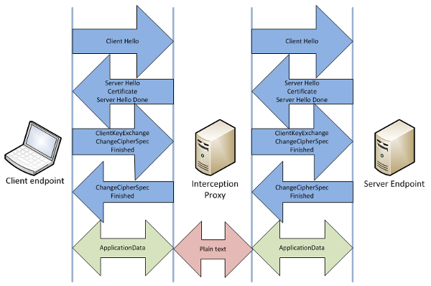

Slide 57
”Legit” MITM
You can do this for SSL/TLS and for SSH
IMHO both are bad ideas. For some cases (large load balanced websites) I can see the need to do the MITM on a load balancer to direct as needed
For SSH this is a TERRIBLE IDEA. TERRIBLE.

Slide 58
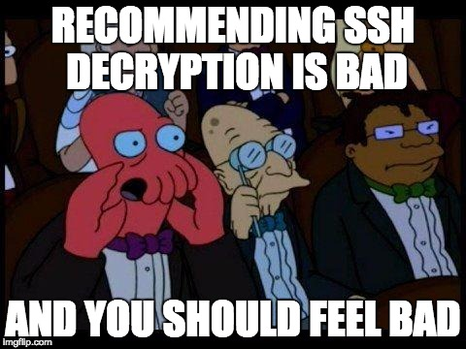
True Story
I sent this to an auditor who recommended we turn on SSH decryption:

Slide 59
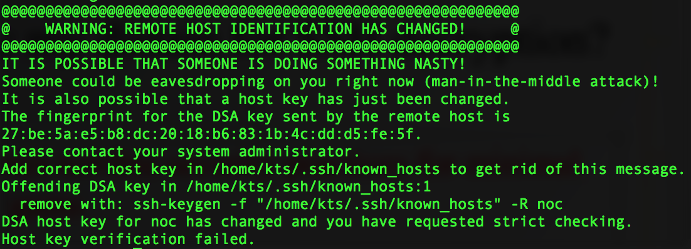
Why my distain for SSH decryption?
It promotes terrible security practices for minimal security gains. Don’t train users to ignore this:

Slide 60
Wireshark
Easy to use GUI
Designed primarily for packet analysis
Also allows for capturing
https://www.wireshark.org/

Slide 61
Wireshark Use Cases
Security – Examine security issues
Network – Troubleshoot network issues
Software Development – Debug protocol issues

Slide 62
Wireshark User Manual
Excellent documentation for Wireshark is available here:
https://www.wireshark.org/docs/wsug_html/ (online HTML)
https://www.wireshark.org/download/docs/user-guide-a4.pdf (PDF)

Slide 63
Wireshark
Preinstalled in SIFT, Kali, etc. but also easy to download and install yourself
https://www.wireshark.org/#download

Slide 64
Installing Wireshark
.exe installer for Windows
.dmg installer for macOS
.tar.bz2 for everything else
uncompress/untar
./configure
make
make install

Slide 65
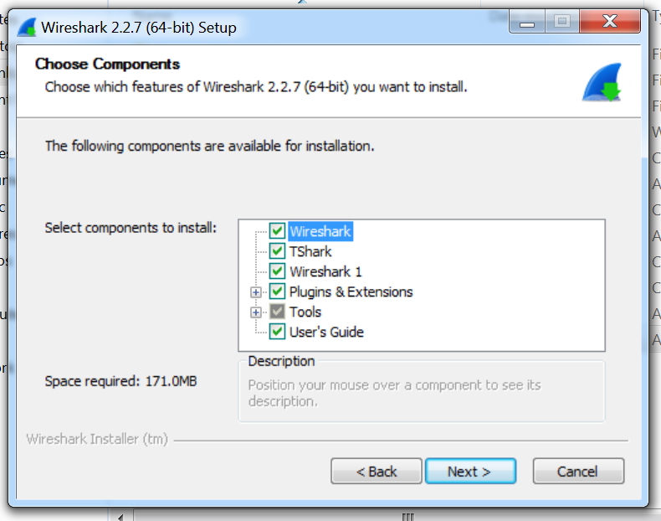
Install All The Things! (Windows)

Slide 66
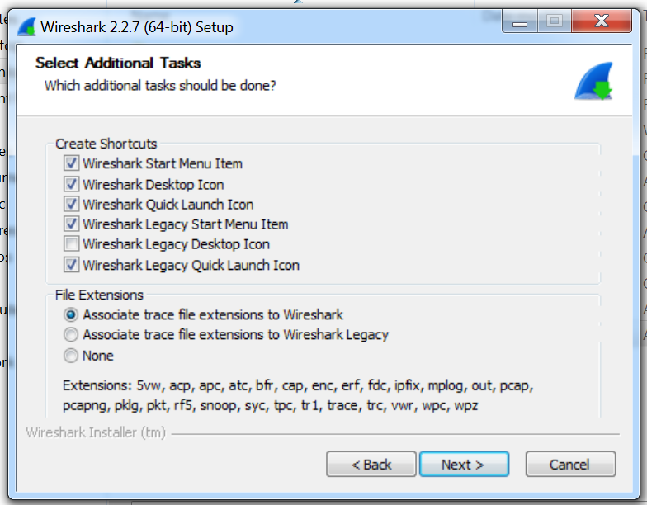
Install All The Things! (Windows)

Slide 67
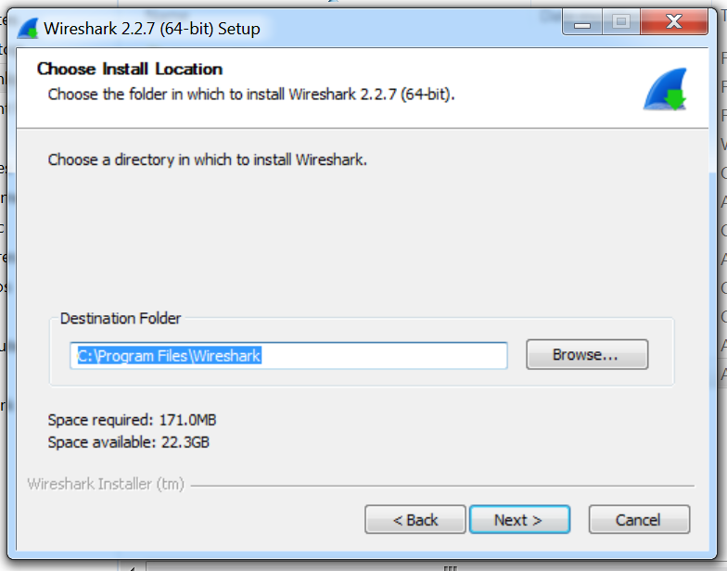
Install All The Things! (Windows)

Slide 68
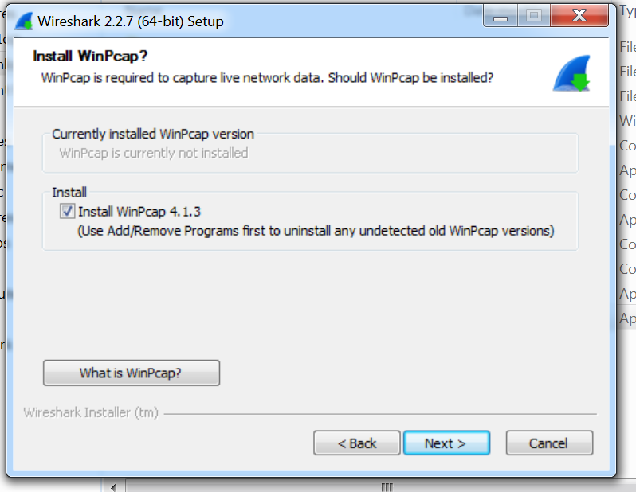
Install All The Things! (Windows)
You
MUST
Install
WinPcap!!

Slide 69
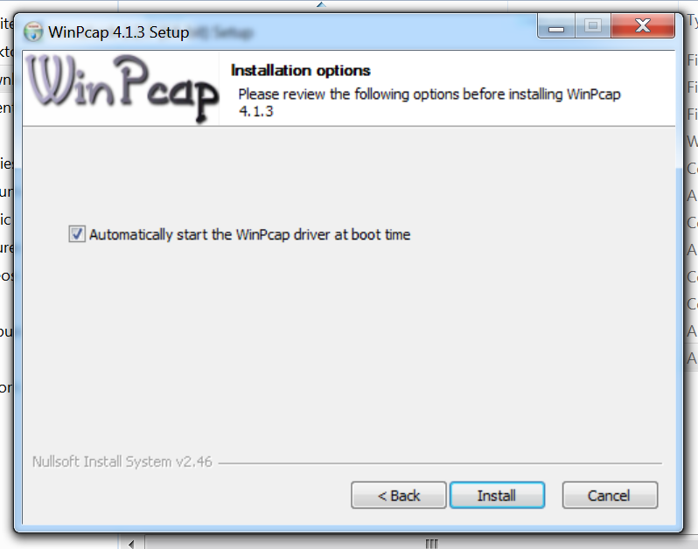
Install All The Things!
In the middle of the the install you’ll get the WinPcap install – leave the default to start at boot time set!

Slide 70
Wireshark Panels
Packet list
Packet details
Packet bytes

Slide 71
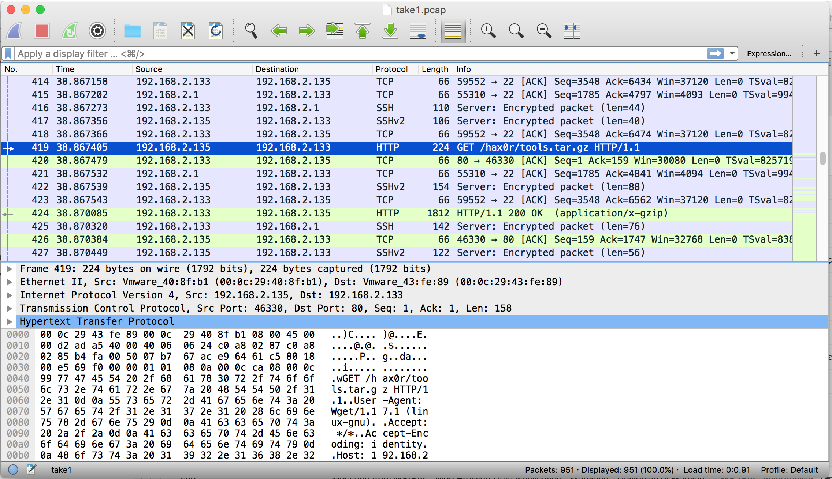

Slide 72
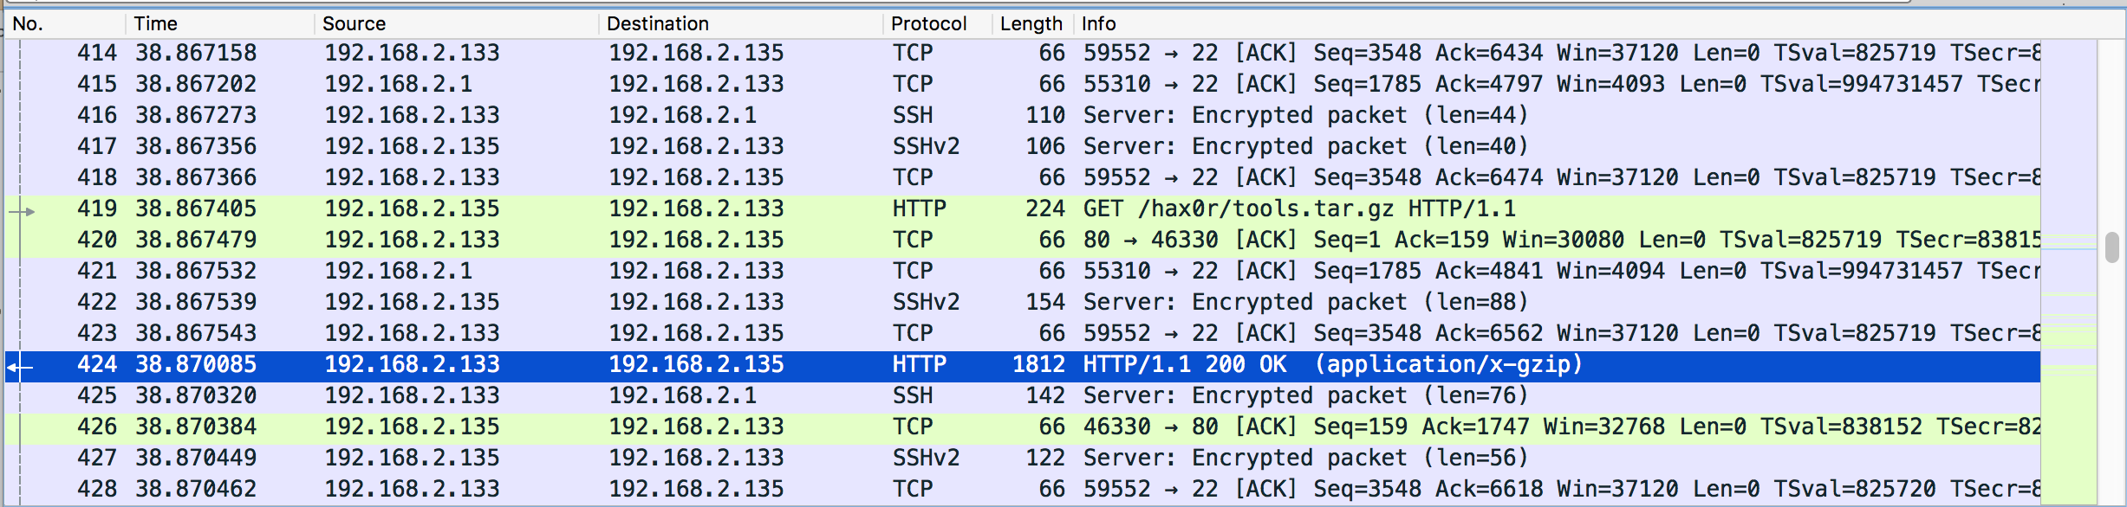
Packet List

Slide 73
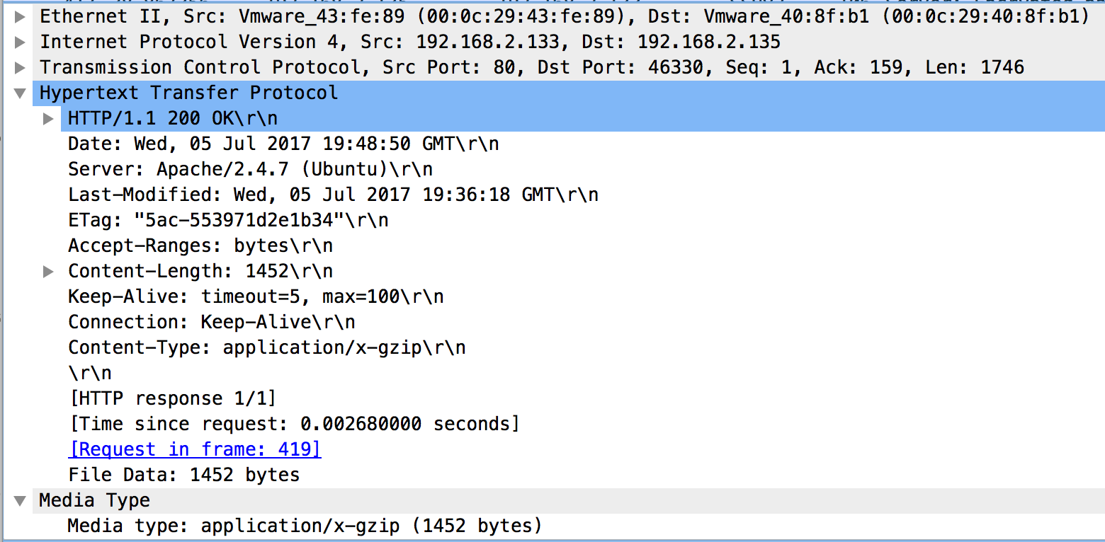
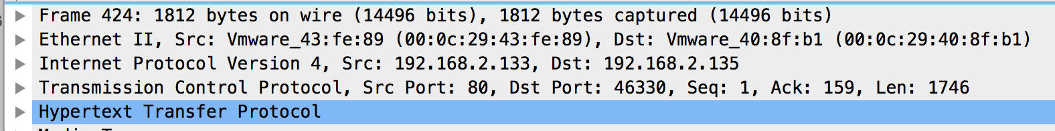
Packet Details

Slide 74
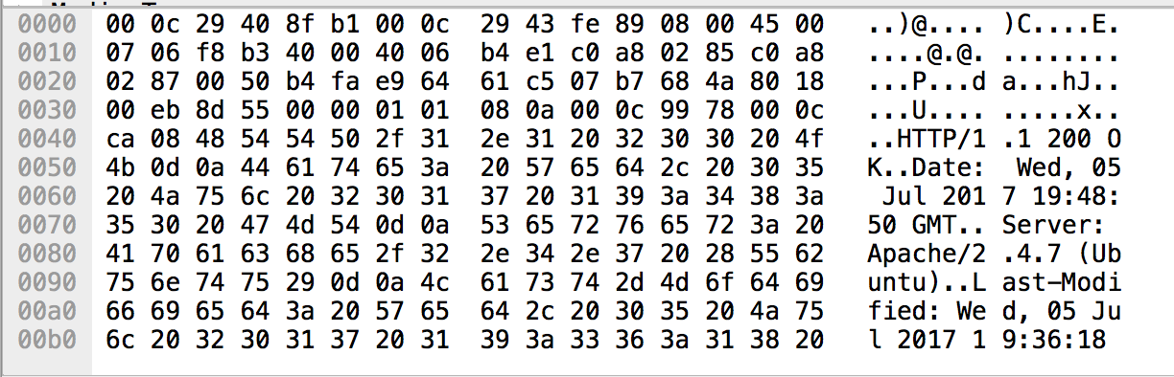
Packet Bytes
The actual content of the packet

Slide 75
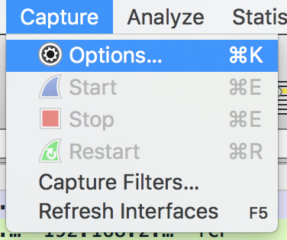
Capturing Packets with Wireshark

Slide 76
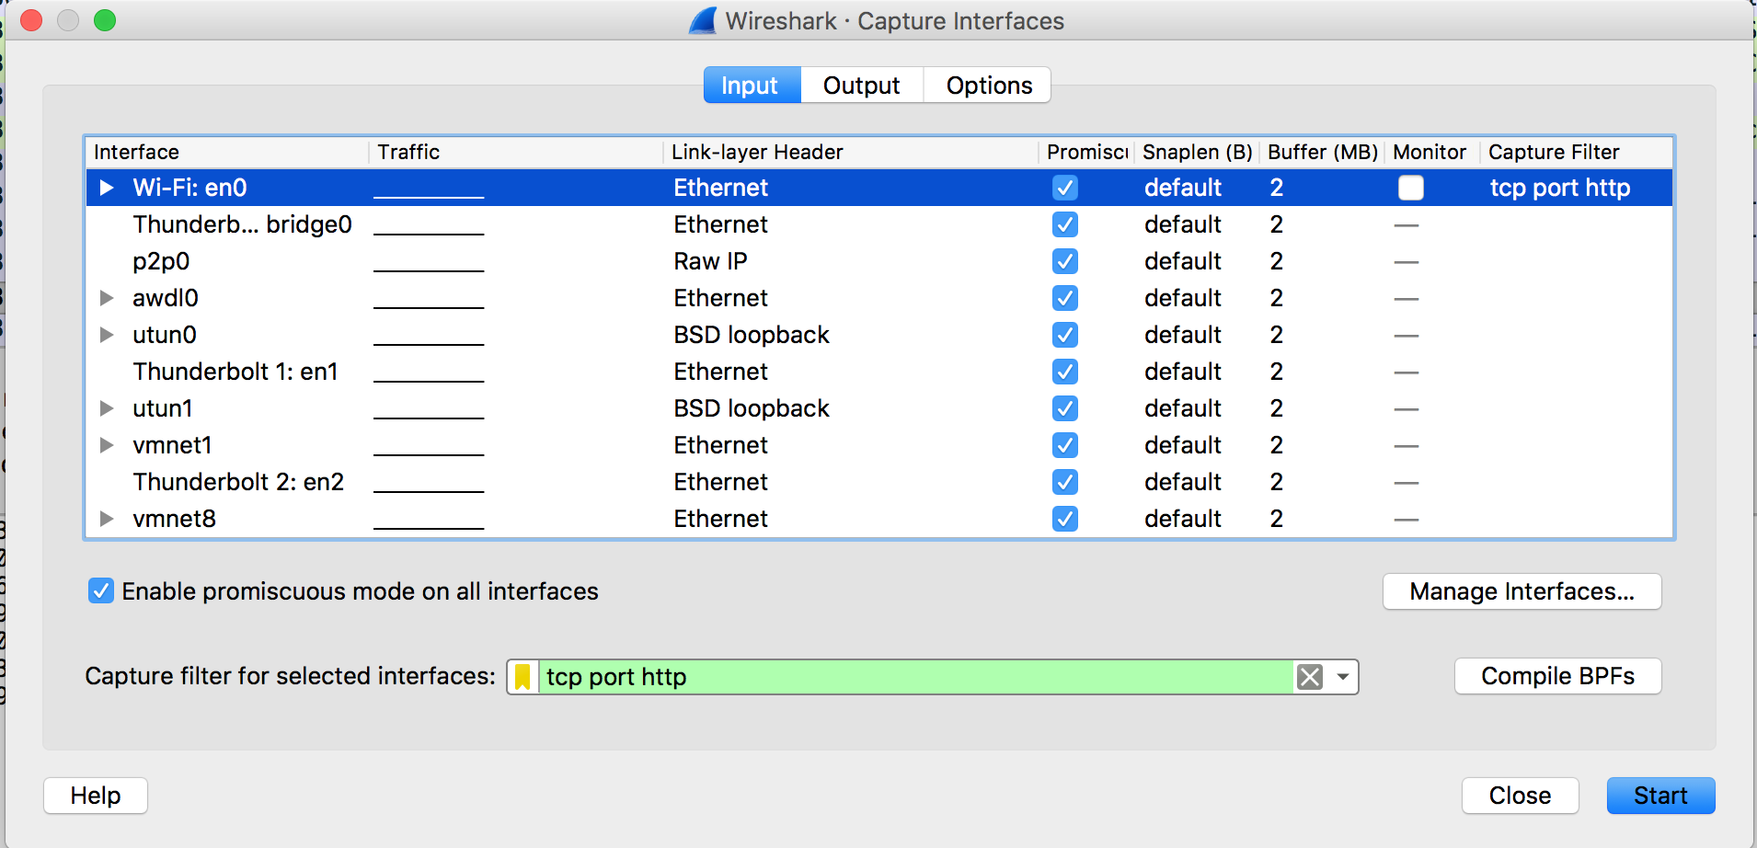
Capturing Packets with Wireshark

Slide 77
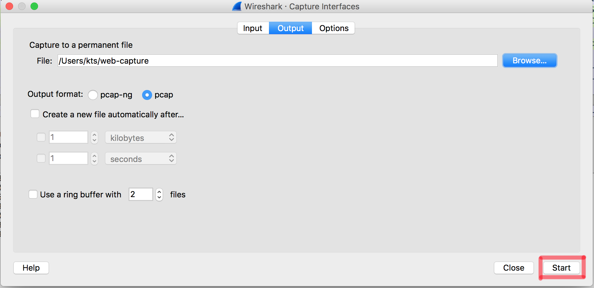
Capturing Packets with Wireshark

Slide 78
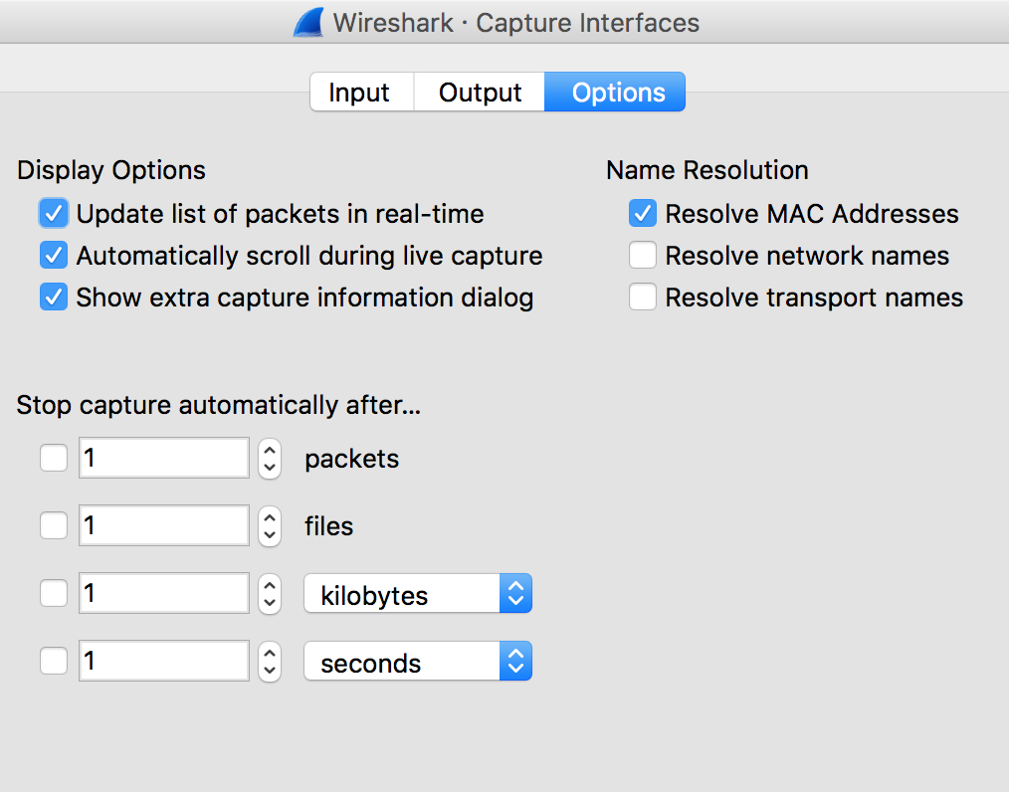
Capturing Packets with Wireshark

Slide 79
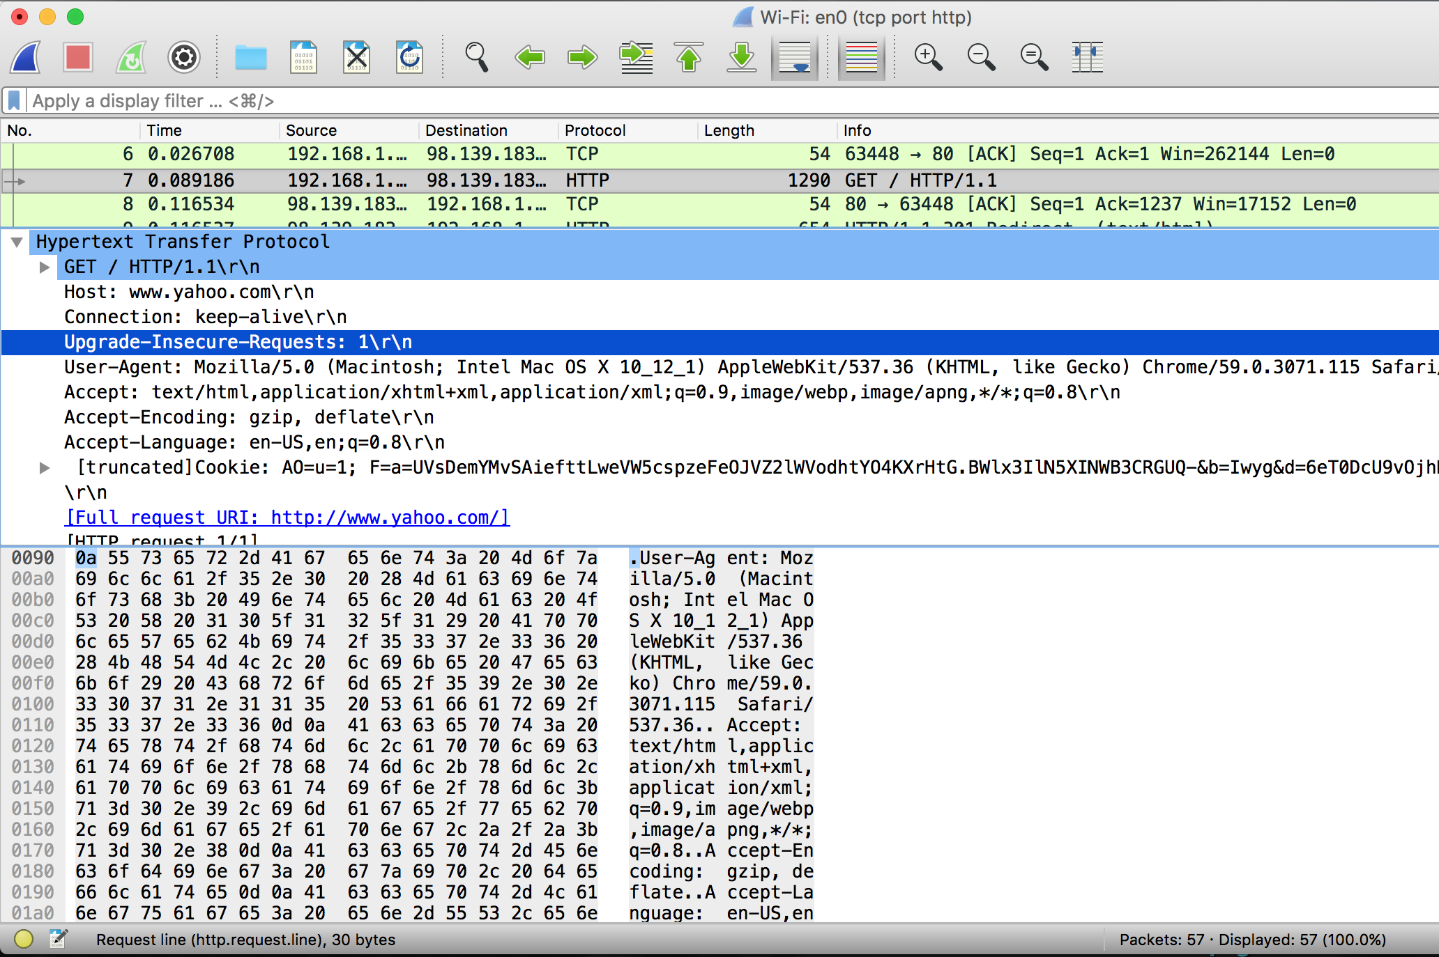

Slide 80
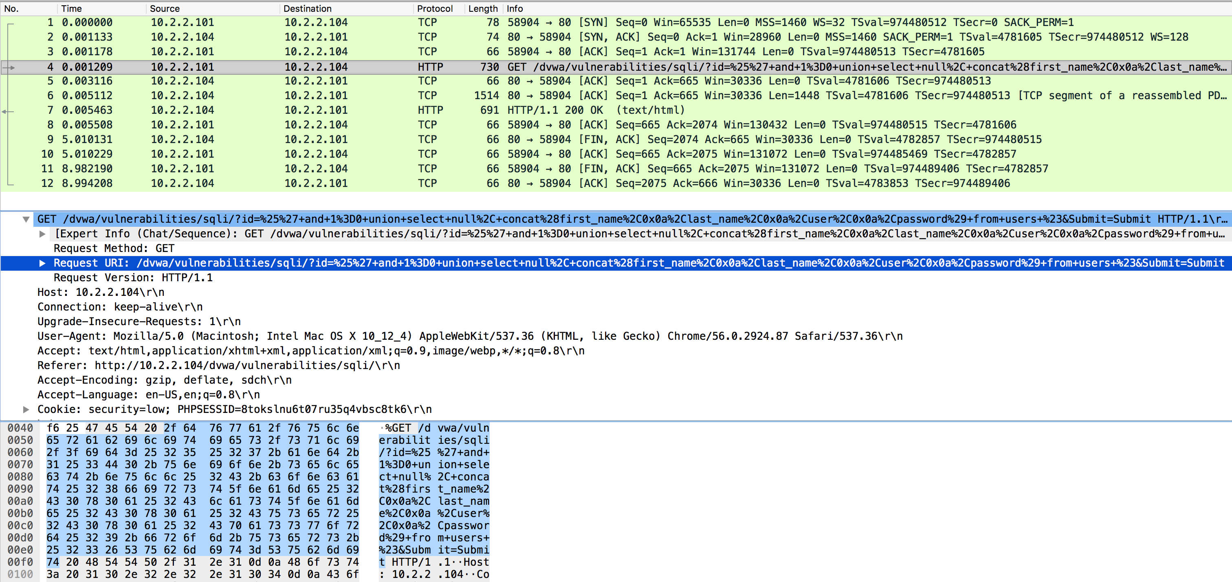
Exercise #3 – SQL injection
Run through the SQL injection packet capture exercise

Slide 81
Analysis of a Packet Capture
Grab the “uploads.pcap” packet capture from the Ubuntu VM
And load it into Wireshark
Double Click the .pcap
File -> Open

Slide 82
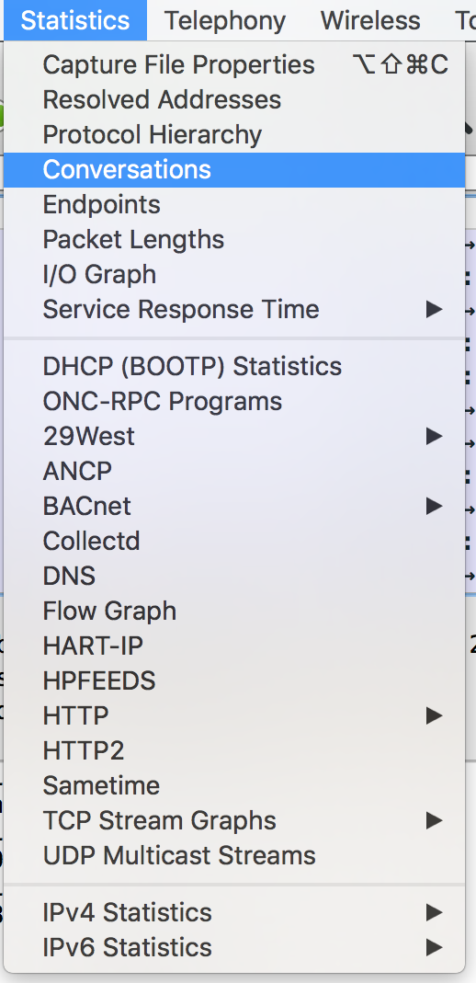
Conversations

Slide 83
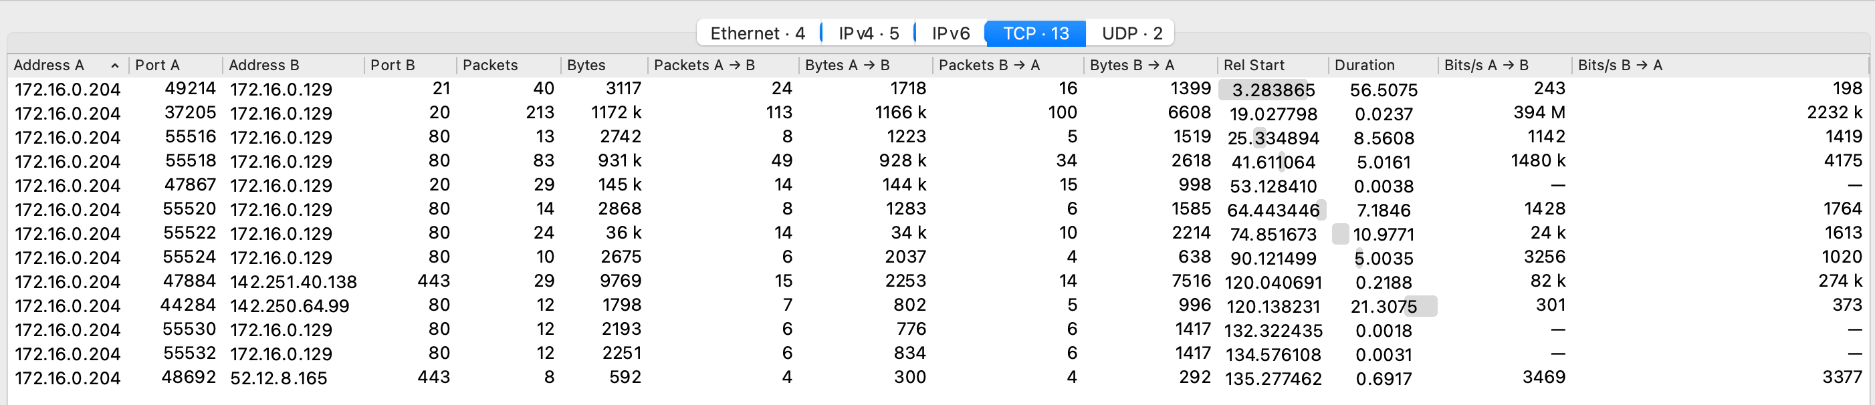
Conversations

Slide 84
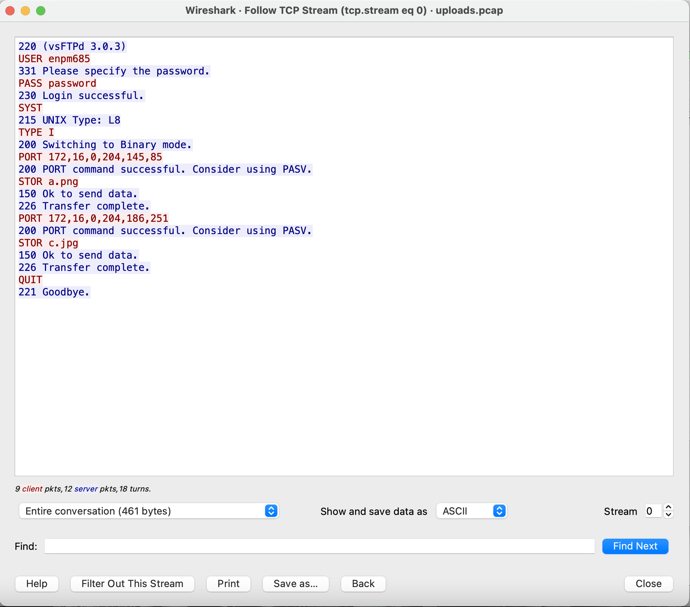
Conversations

Slide 85
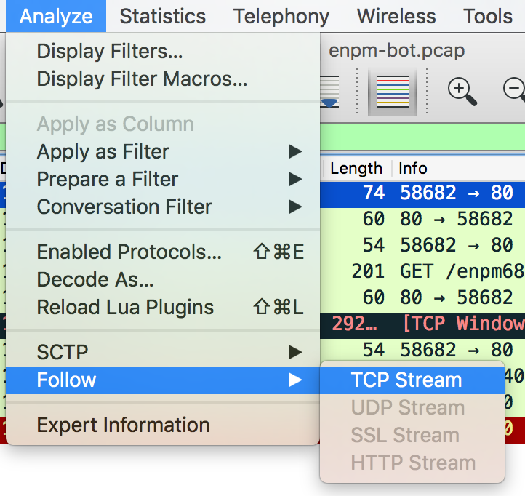
Follow Stream

Slide 86
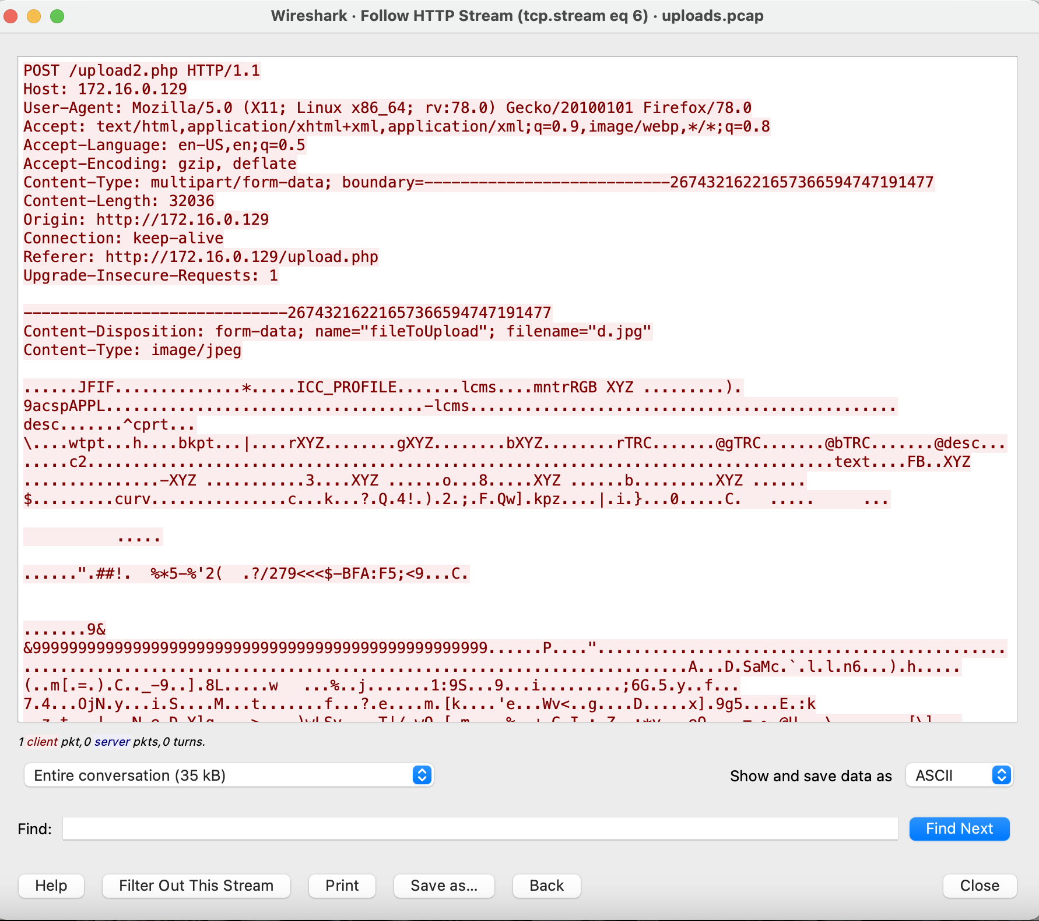
Follow Stream

Slide 87
Packet Examples
Lots of great packet captures are available here: https://github.com/chrissanders/packets
Here too: https://www.malware-traffic-analysis.net/ (*Caution LIVE MALWARE HERE*)

Slide 88
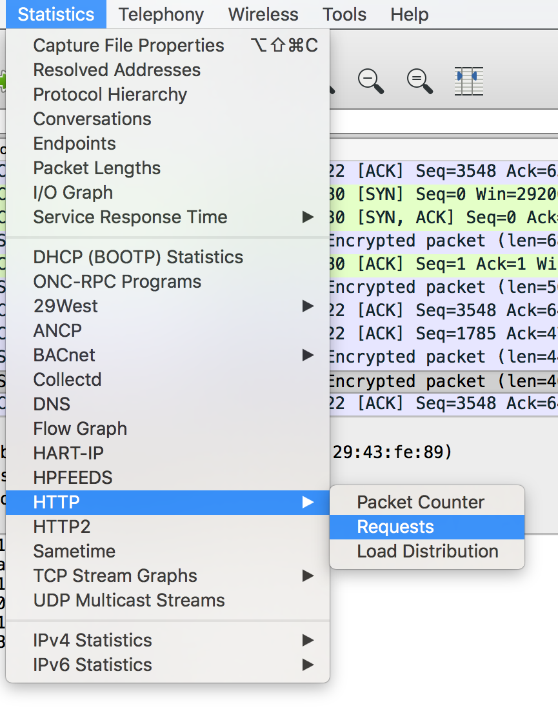
Statistics

Slide 89
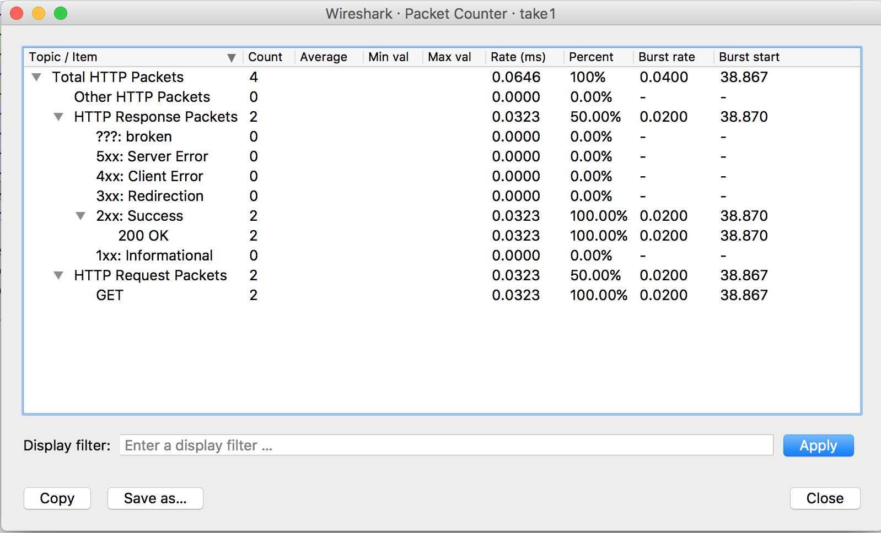
Statistics

Slide 90
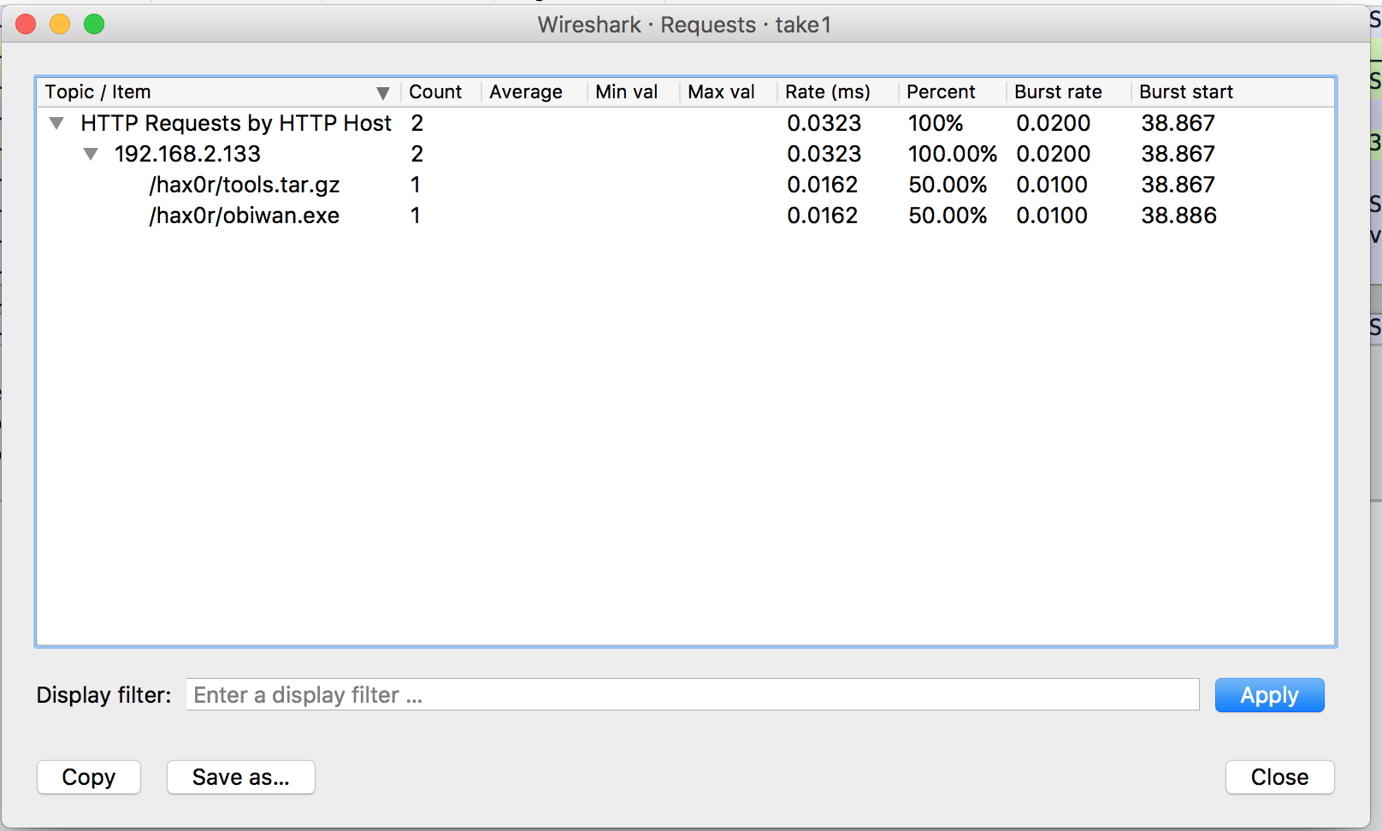
Statistics

Slide 91
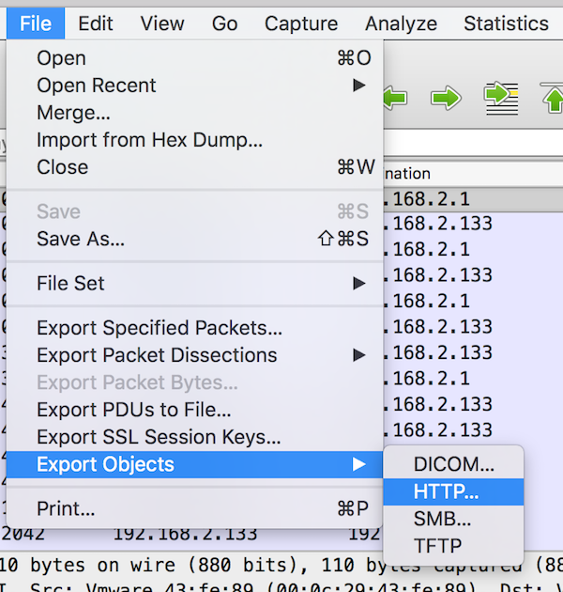
Extract A File From Pcap

Slide 92

Extract File from Pcap
Click the file you want to extract and click “Save”

Slide 93
Some Helpful Filters
!arp (Remove ARP traffic from being displayed)
ip.addr == 192.168.2.157 (Include all traffic to/from 192.168.2.157)
http (Only show HTTP traffic)
tcp.port == 22 (Only show traffic to/from port 22)
tcp contains foo (Display all TCP traffic that contains “foo”)

Slide 94
Wireshark Exercise
Grab the “uploads.pcap” packet capture from the Ubuntu VM and run through Exercise #4

Slide 95
Packet Generators
hping
scapy
tcpreplay

Slide 96
hping3
By default, sends TCP packets with no control bits set to target port 0 continuously, once per second (might get RSTs back)
Protocol selectable via flags:
--udp sends UDP packets
--icmp sends ICMP packets
--rawip sends raw IP packets, with no TCP or UDP bit
syntax for flipping on control bits:
--syn --push
--fin --ack
--rst --urg
# hping --rawip 10.10.10.20

Slide 97
hping Target and Source selection
Target options
--rand_dest IP_addr randomizes targets based on location of an “x” placed in target (i.e. 10.10.10.x targets randomly among 10.10.10.1-255)
--interface [INT] when using --rand_dest must specify the interface to be used
Source options
--spoof [IP_addr] spoofs source IP on packets sent
--rand_source selects random source address for all packets

Slide 98
hping Port Selection and Options
--destport [port]
if preceded by a +, port incr. by 1 for each received response
if preceded by ++, incr for each packet sent
--scan [port_range/list]
--baseport [port] start with this source port and incr for each sent packet
--keep use same source port for each packet sent
--count [N] Send N packets
--beep Beep on receipt of packet
--file [filename] send contents of file as a payload, must be used with --data
--data [N] Length of payload to send, in bytes
Speed: --fast, --faster, --flood, --interval [N]or u[N]

Slide 99
Scapy
Packet Manipulator
Lets you craft and send packets
Decodes packets
Stand alone and a python library
Great intro: http://www.secdev.org/conf/scapy_csw05.pdf

Slide 100
Scapy
# scapy (in Kali)
Ping:
>>> ans,unans=sr(IP(dst="192.168.103.1-254")/ICMP())
>>> ans.summary( lambda(s,r) : r.sprintf("%IP.src% is alive") )
TCP SYN Port Scanning
>>> res,unans = sr( IP(dst="192.168.103.155")/TCP(flags="S", dport=(1,1024)) )
>>> res.nsummary( lfilter=lambda (s,r): (r.haslayer(TCP) and (r.getlayer(TCP).flags & 2)) )

Slide 101
tcpreplay
Replays pcaps across the network

Slide 102
Wireless Sniffing
NetStumbler
inSSIDer
Aircrack
Kismet
Kismac

Slide 103
Monitor Mode
Applies to wireless data transfer
Allows packet capture without associating with a network
Of limited use (involved in WEP attacks, looking for unencrypted data, etc.)

Slide 104
Netflow
Protocol for collecting IP traffic metadata
Developed by Cisco
Well supported
Many companies use something functionally equivalent but named differently (Jflow, NetStream, etc.)

Slide 105
Flow Records
interfaces in and out
timestamps
bytes and packets sent
Layer 3 headers
SRC & DEST IP, Port for UDP, TCP
ICMP Type and Code
IP protocol
Type of Service
Layer 3 routing information
next hop and SRC & DEST IP masks
Version 9 (latest)
MPLS info
IPv6 ADDR and Ports

Slide 106
Flow Limitations
Huge amount of data
Sampling sometimes necessary

Slide 107
Tools
nf (netflow monitor)
nfdump
nfsen (vizualization)
flow-tools
Lancope (now Cisco)
Arbor Networks
SevOne
SolarWinds
HP
Fluke

Slide 108

nfdump
Displays netflow data
Can manipulate and analyze this data
nfreplay can also replay these flows

Slide 109
Netflow – So what?
Lots of valuable information can be gleaned from this meta data
Source/Dest, Time of connection, how long connection was for, how much data was sent

Slide 110

Netflow – So what?
Time: 9/5/17 @ 9:50-10:03am
Protocol: UDP (hmmm)
Src IP: 128.8.103.138
Dest IP: 216.58.218.234
Dest Port: 443 (hmm usually SSL/TLS)
Bytes: 51 – 7880 (small but some data xfer)
216.58.218.234 = iad23s40-in-f234.1e100.net
(Google CDN)
Looks like someone was communicating with Google!

Slide 111

Nfsen – Web UI for nfdump

Slide 112
DNS
DNS logs can be extremely useful to see what hosts on your network are talking to
(Netflow gives you that but with IP addresses. With a plethora of systems using CDNs or virtual hosting the DNS logs can give you a lot more useful information)

Slide 113

IP addresses are only ½ the battle

Slide 114



Slide 115
Jul 4 23:01:24 128.8.76.2 named 20051 client 10.102.8.56#1687 (hqmpxgmqfyj.umd.edu): view 2: query: hqmpxgmqfyj.umd.edu IN A + (128.8.76.2)
Jul 4 23:01:24 128.8.76.2 named 20051 client 10.102.8.56#30126 (qmcbolkhfizfcr.umd.edu): view 2: query: qmcbolkhfizfcr.umd.edu IN A + (128.8.76.2)
Jul 4 23:01:24 128.8.76.2 named 20051 client 10.102.8.56#52641 (dkuqtugrvqryg.umd.edu): view 2: query: dkuqtugrvqryg.umd.edu IN A + (128.8.76.2)

Slide 116
fqtag.com = known spyware-ish domain
Jul 4 23:14:17 128.8.74.2 named 25439 client 128.8.68.250#56596 (fqtag.com): view 2: query: fqtag.com IN A + (128.8.74.2)
Jul 4 23:12:24 128.8.76.2 named 20051 client 129.2.10.47#57676 (fqtag.com): view 2: query: fqtag.com IN A + (128.8.76.2)
Jul 4 23:12:07 128.8.74.2 named 25439 client 10.104.161.134#50243 (www.fqtag.com): view 2: query: www.fqtag.com IN AAAA + (128.8.74.2)
Jul 4 23:12:05 128.8.74.2 named 25439 client 10.105.159.84#65227 (www.fqtag.com): view 2: query: www.fqtag.com IN A + (128.8.74.2)
Jul 4 23:12:05 128.8.74.2 named 25439 client 129.2.230.242#50667 (www.fqtag.com): view 2: query: www.fqtag.com IN A + (128.8.74.2)
Jul 4 23:11:56 128.8.76.2 named 20051 client 129.2.10.67#60351 (fqtag.com): view 2: query: fqtag.com IN A + (128.8.76.2)

Slide 117
Network Forensics on Host
Sysinternals tools can be of assistance here

Slide 118

TCPView

Slide 119

Process Explorer

Slide 120

Process Explorer

Slide 121
Tor
“The Onion Router”
Open source software that allows anonymous communication
Think of it as an encrypted internet overtop of the regular internet
Many people/organizations run Tor nodes (relays) which act as routers for network traffic to flow through the Tor network
Idea originally developed by the Naval Research Lab

Slide 122
Tor
Encryption is performed in the application layer
A circuit is build to sent the data from you to the destination
All data, including the destination IP address is encrypted multiple times and send to a random Tor node for the next hop.
Each relay node decrypts a layer of encryption to find the next hop
Final relay node decrypts the traffic and sends the original data, yet that relay node doesn’t know the source address
As you can imagine this is slooooooow

Slide 123

https://www.torproject.org/about/overview.html.en

Slide 124
Exit Node
Where the encrypted Tor network ends and is decrypted into regular traffic to access non-Tor resources on the regular internet
“The last mile of Tor”

Slide 125
Blocking Tor Exit Nodes
There are many public lists of Tor Exit Nodes so it’s easy to add these to blocking systems (firewalls, IPS, etc) to effectively block anyone using Tor from accessing you.
Since some Tor exit nodes can come and go you need to update your blocking list frequently
https://check.torproject.org/cgi-bin/TorBulkExitList.py
https://check.torproject.org/cgi-bin/TorBulkExitList.py?ip=8.8.8.8&port=
https://check.torproject.org/exit-addresses
https://torstatus.blutmagie.de/
Scripting might be useful here

Slide 126
Hidden Services
These are systems that reside entirely in Tor so no exit nodes are used to access, the entire connection is encrypted and not easily traceable.
Access with the .onion top level domain
Ex: http://silkroad6ownowfk.onion
Makes where the servers that host these services very hard to find
Popular with illicit goods/services for sale.

Slide 127
Tor Browser
Easy way to access the web via Tor
https://www.torproject.org/projects/torbrowser.html.en

Slide 128


Slide 129


Slide 130
tor in Kali
apt-get install tor
apt-get install deb.torproject.org-keyring
Edit /etc/tor/torrc as needed to configure SOCKS proxy, password, control port, etc.

Slide 131
Turn a Raspberry Pi into a Tor router
Take a Raspberry Pi and a wireless NIC that supports monitor mode
Tons of tutorials for this
https://learn.adafruit.com/onion-pi/overview
https://makezine.com/projects/browse-anonymously-with-a-diy-raspberry-pi-vpntor-router/
http://www.instructables.com/id/Raspberry-Pi-Tor-relay/
http://www.techradar.com/how-to/computing/how-to-use-a-raspberry-pi-to-browse-anonymously-1305789
https://www.raspberrypi.org/blog/onion-pi-tor-proxy/
If using a wireless NIC on one end don’t forget to give your SSID a neat name like “FBI Mobile Surveillance Van 39”

Slide 132
Weaknesses
Use of Tor can be detected through traffic analysis
This is how Silk Road’s Dread Pirate Scott was discovered
Rogue tor exit nodes can capture your data in transit
Rogue tor relay and exit nodes
Circuit Fingerprinting - https://www.usenix.org/system/files/conference/usenixsecurity15/sec15-paper-kwon.pdf
Super secret -5days used by NSA

Slide 133
Homework #5
You’re a SOC analyst working for a large organization. Someone in your organization alerted you to a suspect executable on their computer that they did not recognize and they have sent it to you for further analysis.
Analyze the packet capture and determine what it is doing, and if the suspect executable is malicious or not.

